Slide 1

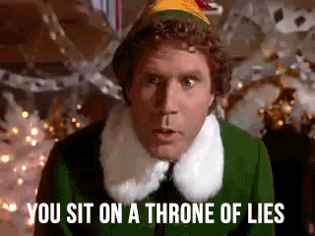
Name that movie

Slide 2
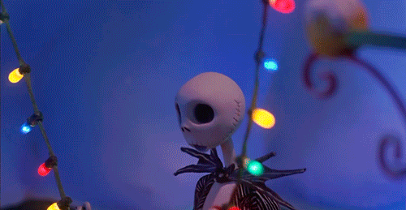
Name that movie

Slide 3
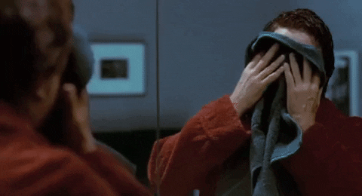
Name that movie

Slide 4
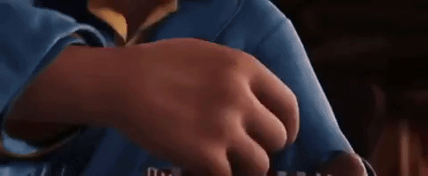
Name that movie

Slide 5
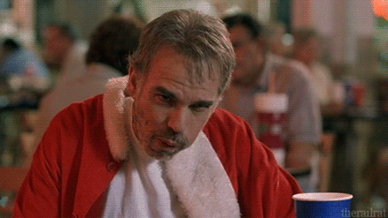
Name that movie

Slide 6
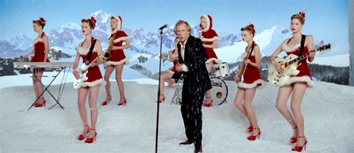
Name that movie

Slide 7
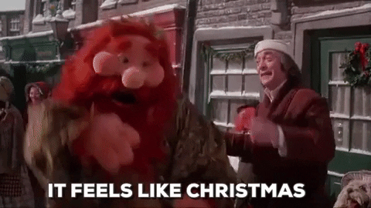
Name that movie

Slide 8
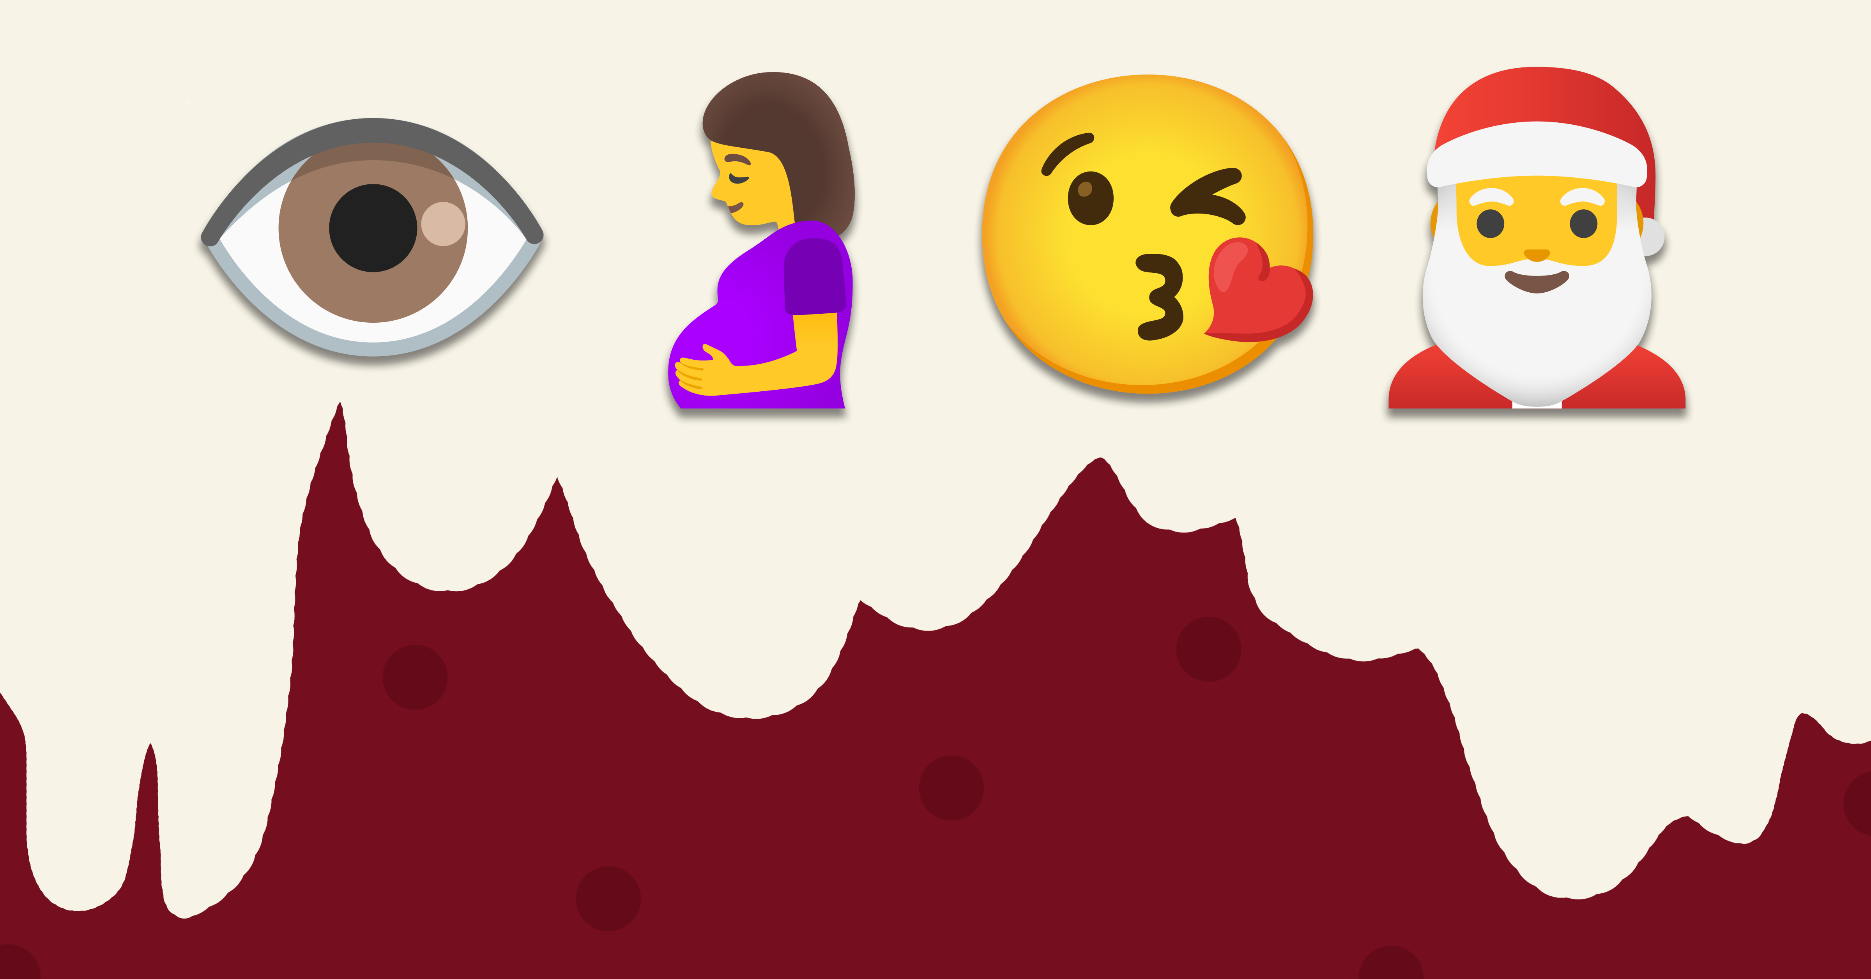
Name the song

Slide 9


Name the song

Slide 10
In what year did Christmas Day and New Year’s Day fall in the same year?

Slide 11
What is the best way to spread Christmas cheer, according to Buddy the Elf?

Slide 12
Which country has donated a Christmas tree to the UK every year since 1947?

Slide 13
What festive song ends the popular Christmas film
Die Hard?

Slide 14
What gift does Harry Potter receive from the Dursleys during his first Christmas at Hogwarts?

Slide 15
Who created The Nutcracker ballet?

Slide 16
Which country traditionally eats KFC on Christmas Day?

Slide 17
Which chocolates were set to be removed from tubs of Celebrations, but were saved following a public outcry?

Slide 18
How many ghosts show up in A Christmas Carol?

Slide 19
In the most recent Gavin and Stacey Christmas Special, what presents do Nessa and Neil (the baby) give everyone?

Slide 20
Which Christmas song came first?
A – White Christmas, Bing Crosby
B – The Christmas Song, Nat King Cole
C – Feliz Navidad, José Feliciano
D – Blue Christmas, Elvis

Slide 21
In Love Actually, character Billy Mack famously sings a cover called Christmas is All Around. Who sang Love is All Around?

Slide 22
Who sings the first line of Band Aid’s Do They Know It’s Christmas (1984)?

Slide 23
How many Home Alone films are there?

Slide 24
Which Boro legend will be celebrating their birthday on Christmas Day?
A – Bob Mortimer
B – Chris Kamara
C – Chris Rea

